Slide 1
Data-Driven Analysis of Conflict, Refugee Movements, and Food Insecurity in Sudan

Slide 2
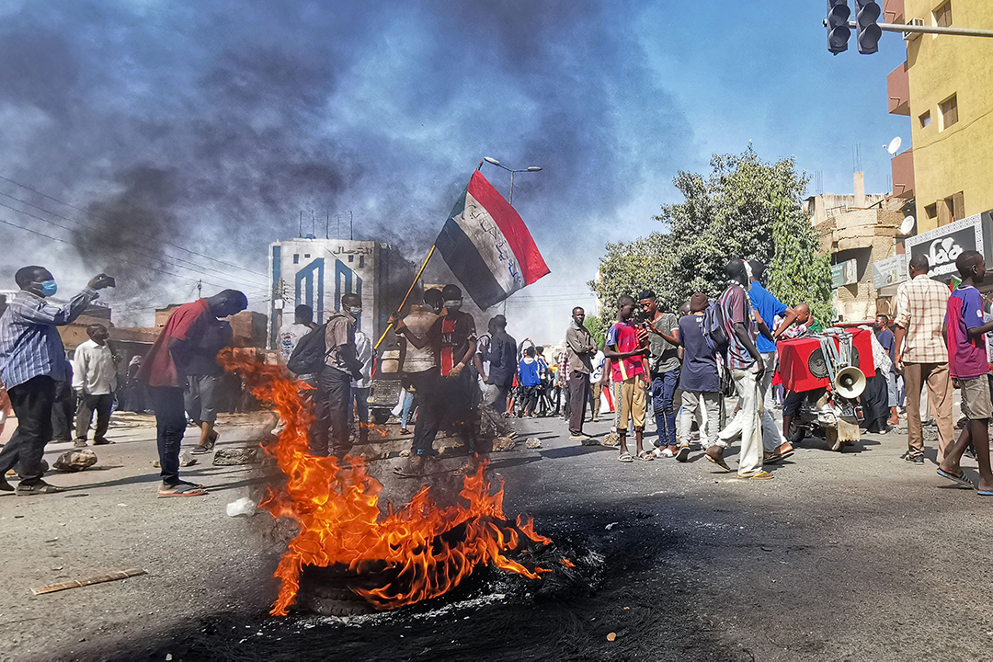

Slide 3
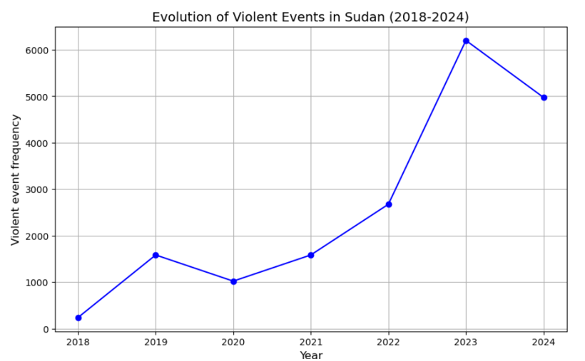
INTRODUCTION
Since April 2023, Sudan has been embroiled in a civil conflict between the Military Forces of Sudan and the Rapid Support Forces (RSF).
The number of political violence events has nearly doubled, increasing from 3,000 in 2022 to approximately 6,000 events since the onset of the war, as illustrated in the line chart.
This conflict stems from long-standing political, economic, and social grievances, compounded by power struggles and competition for resources.
This presentation will analyze the civilian war in Sudan, focusing on the profile and nature of the conflict, as well as the connections between political violence, refugee movements, and food insecurity.

Slide 4
SUMMARY
In this analysis, I first evaluated the profile and nature of conflicts in Sudan using ACLED data from January 2023 to October 4, 2024. I focused on three key areas: the most frequent event types since the war began, the primary actors involved by counting their occurrences in conflict events, and the locations most affected, measured by fatalities. The results indicate that direct confrontations, namely battles between state military forces and rebel groups, are the most significant incidents. The main actors identified are the Rapid Support Forces and the Sudanese Armed Forces, with civilians often suffering the consequences. This analysis will be discussed further in Section 1 of the presentation.
In section 2, I investigated the relationship between political violence, refugee movements, and food insecurity. For the first part of this analysis, I used ACLED data to track the evolution of political violence in recent months, alongside UNHCR data to examine the flow of individuals fleeing Sudan since the onset of the conflict. The analysis revealed a strong positive correlation between these two factors. Furthermore, employing data from the Famine Early Warning Systems Network (FEWS NET), I assessed the classification of regions most affected by political violence both before and after the outbreak of war. The results indicate a significant deterioration in food insecurity levels as the war progresses, highlighting an alarming issue for the future.
The section 3 will discuss the risks to anticipate for Sudan based on these analyses and will provide actionable recommendations for future interventions.

Slide 5
Section 1: Conflict and Violence Analysis

Slide 6
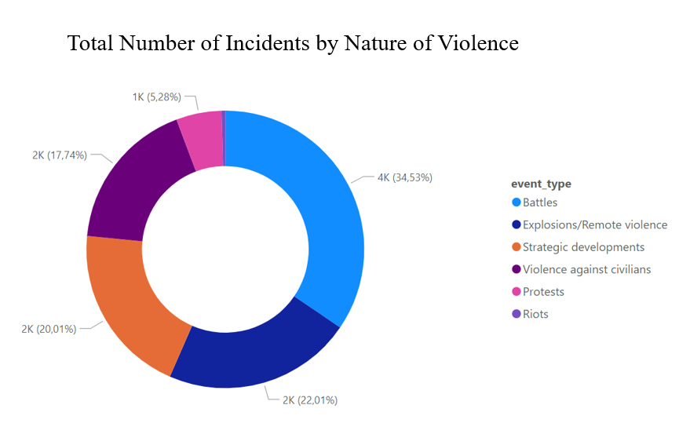
1. a) Profile and Nature of violence
The violence in Sudan is primarily characterized by battles ( nearly 35%) - involving direct confrontations between the SAF and RSF – and explosions/remote violence ( 22%) such as air/drone strikes.
These violent events stem from the power struggle between the State army and the rebel group both seeking control over key regions.
The conflict is centered around territorial control, with battles accounting for the majority of violent incidents.

Slide 7
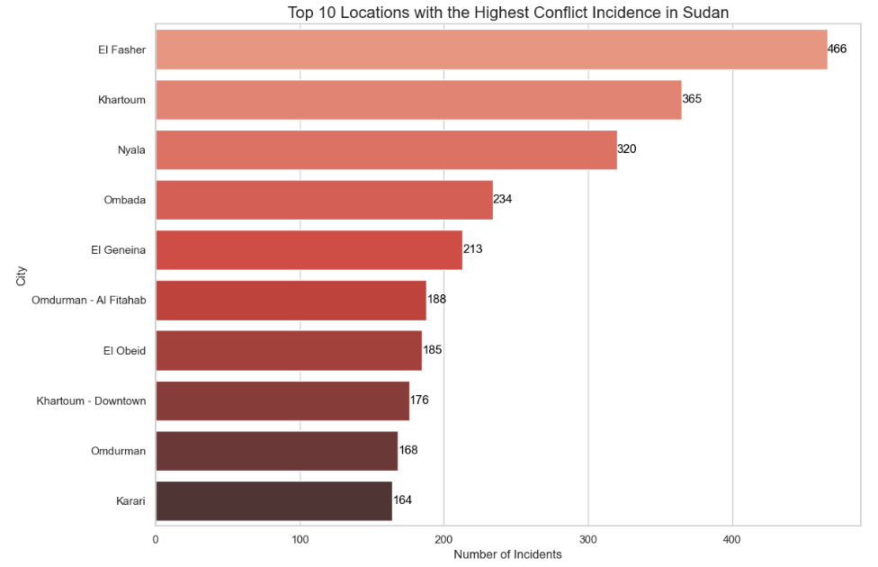
1. b) Conflict Epicenters
Since April 2023, more than 20,000 people have lost their lives, with thousands more injured in the ongoing conflict in Sudan.
The violence is heavily concentrated in specific regions, with Khartoum, El Fasher, Nyala, Wad Medani, and Omdurman being the cities most affected.
While El Fasher and Khartoum remain the epicenters of fighting, El Geneina has witnessed the highest death toll, with 344 fatalities recorded, followed by El Obeid, with 339 deaths. These cities highlight the tragic human cost of the conflict, with civilians bearing the brunt of the violence.

Slide 8
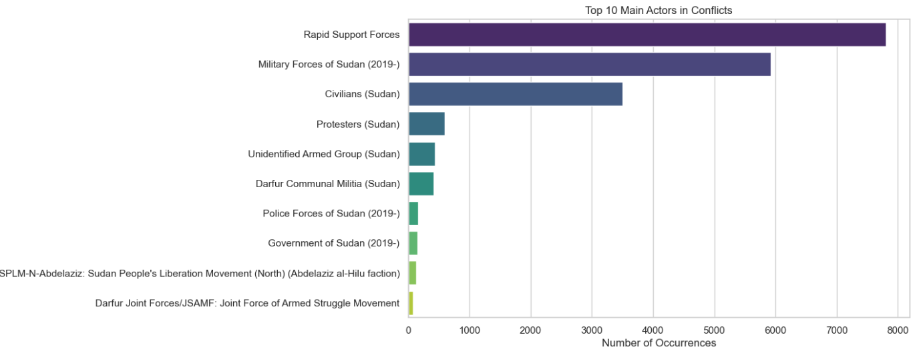
1. c) Central Figures of the Conflict

Slide 9
1. c) Central Figures of the Conflict
As illustrated in the bar graph above, since the onset of the conflict, the two primary groups driving the violence in Sudan are the Military Forces of Sudan(2019) and the Rapid Support Forces (RSF).
The RSF, a paramilitary group, is actively seeking to expand its territorial control, while the SAF, representing the state’s military, is engaged in fierce battles to repel RSF advances and regain lost ground. These two forces are behind the majority of the violent incidents across the country.
Caught in the crossfire are civilians and protesters, who suffer significantly as the conflict rages on.
Additionally, smaller groups such as local militias and police forces have also played a role in certain confrontations, though their involvement is less prominent compared to the main actors.

Slide 10
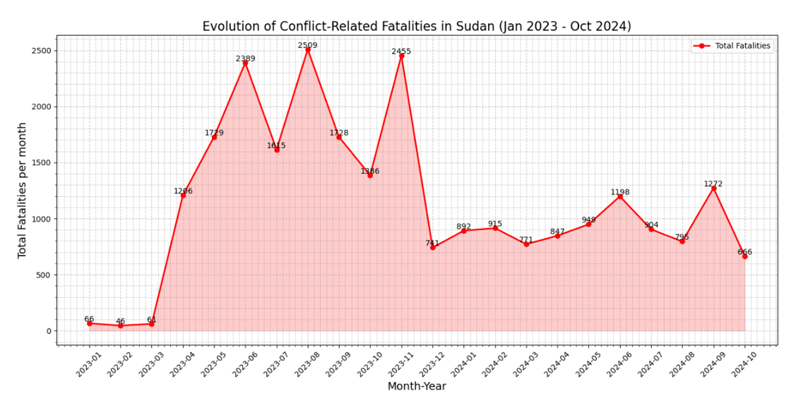
1. d) Changing Patterns in Conflict Dynamics ?
Although the conflict remains intense, 2024 shows a clear downward trend in fatalities.
After peaking early in the year, fatalities stabilized below 1,000 per month, fluctuating between 500 and 1,500.
A brief spike in July and August saw around 1,200 deaths.
While October and the year are not yet over, fatalities are significantly lower compared to the conflict’s earlier months.

Slide 11
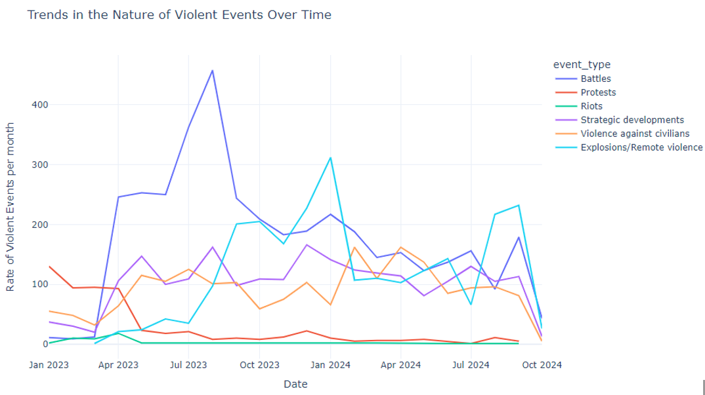
1. d) Changing Patterns in Conflict Dynamics ?
In terms of violence, confrontations peaked dramatically in mid-2023, while other forms of conflict showed greater variability and lower intensity.
Violence against civilians and strategic actions remained steady, while incidents involving explosive devices occurred intermittently, with varying peaks throughout the conflict.
The key actors involved have largely remained the same, with no significant shifts among the primary players in this ongoing crisis.
This evolving situation highlights the persistent nature of the conflict, characterized by high levels of violence even as fatalities begin to show signs of decline.

Slide 12
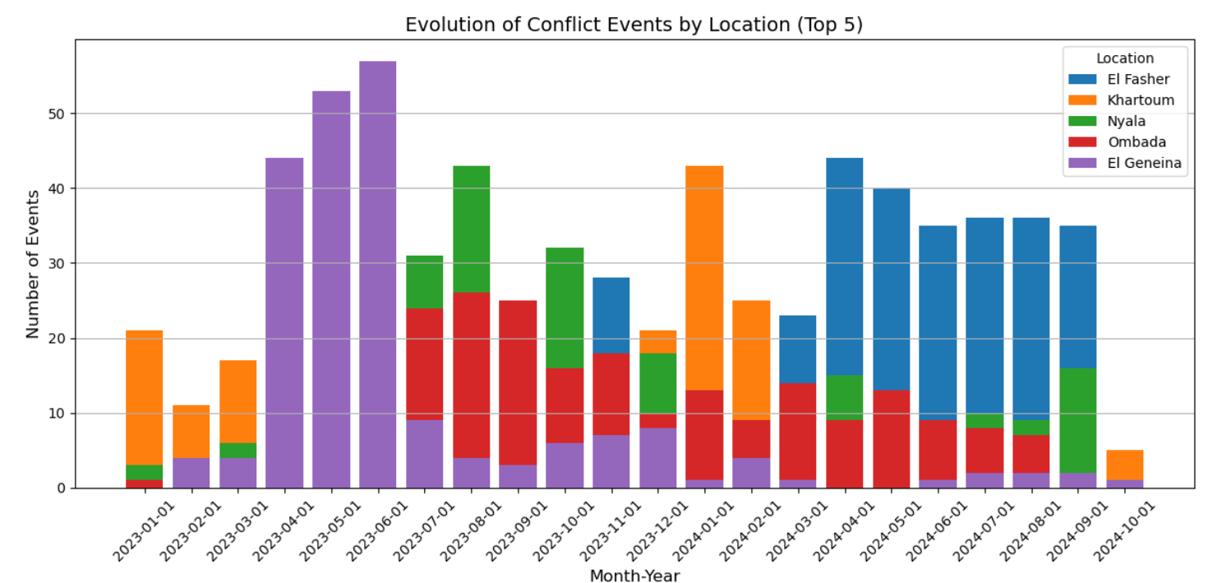
1. d) Changing Patterns in Conflict Dynamics ?

Slide 13
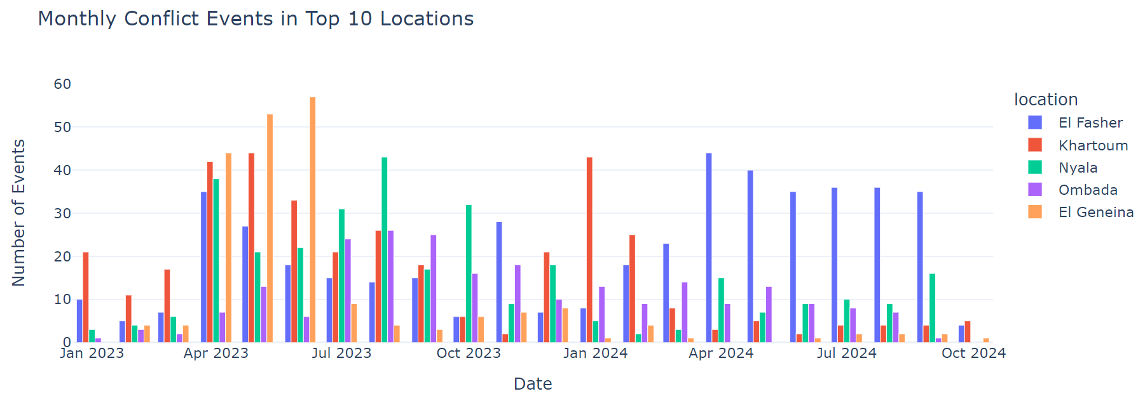
1. d) Changing Patterns in Conflict Dynamics ?

Slide 14
1. d) Changing Patterns in Conflict Dynamics ?
From April to July 2023, Khartoum, El Geneina, and Nyala experienced significant peaks in violent events, indicating widespread conflict across urban and rural areas.
However, as 2024 began, the focus of violence shifted primarily to El Fasher, which saw a resurgence in conflict during April and July 2024
By late 2024, a decline in violent events was observed across all locations, suggesting a broader reduction in conflict intensity and potential de-escalation.
El Fasher emerged as the new epicenter of violence in 2024, with a general trend toward decreasing conflict intensity observed up until early October. However, recent events reveal ongoing volatility, as the city of El Fasher remains under bombardment by the rebel group (RSF), targeting the capital of Western Darfur.

Slide 15
Section 2: Link between Political Violence and Refugees and/or Food Security

Slide 16
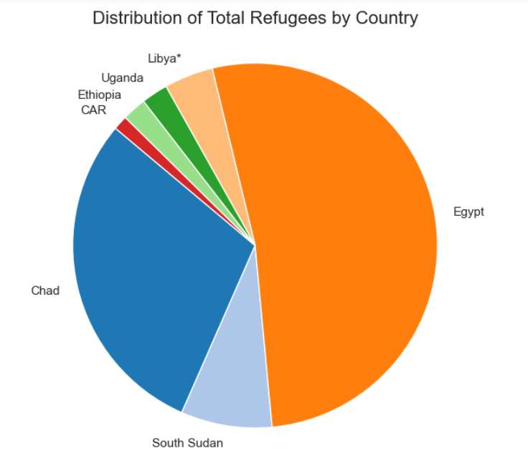
2. a) Political Violence and Refugees
According to UNHCR data, following the outbreak of conflict in Sudan in mid-April 2023, many civilians have been compelled to escape, including those who were already internally displaced as well as refugees from other nations who had sought refuge in Sudan.
Hundreds of thousands have crossed into neighboring countries particularly Uganda, Chad, Egypt, Libya, Ethiopia, South Sudan and the Central African Republic (CAR).
Additionally, some individuals have relocated within Sudan.
As of now, arrived ref approximately 2.9 million newly refugees have been recorded in these countries

Slide 17
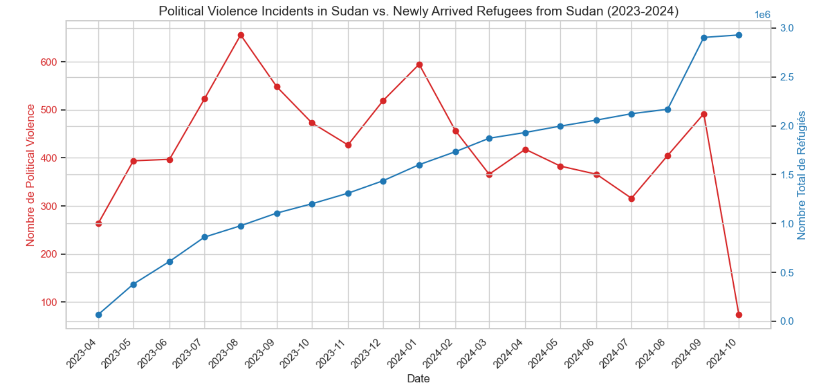
2. b) Political Violence and Refugees
The dramatic increase in refugee numbers is closely linked to rising political violence, driving many to seek safety in neighboring countries. The accompanying figure shows a strong correlation between incidents of political violence and refugee movements, particularly evident during spikes in July 2023 and early 2024.
Even after peaks in violence decline, refugee numbers continue to rise, indicating a lag effect where persistent insecurity and loss of livelihoods compel individuals to flee despite reduced immediate threats.
In summary, evidence supports a positive relationship between political violence in Sudan and highlights the lasting impacts of conflict, with ongoing instability sustaining refugee flows.

Slide 18
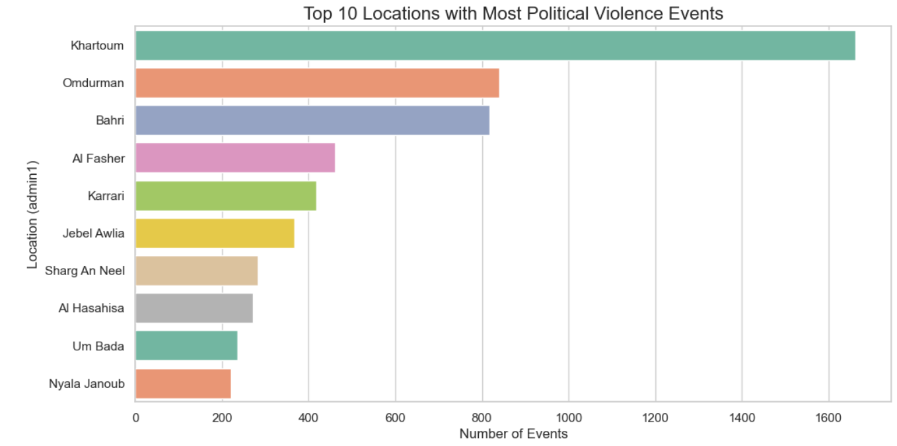
2. c) Political Violence and Food Insecurity
Political violence and food insecurity are closely intertwined, as conflict often disrupts food production, distribution, and access to essential resources.
In regions affected by political violence, agricultural activities can be halted, markets can be destroyed, and humanitarian aid may struggle to reach those in need. This creates a vicious cycle where violence exacerbates hunger, and food insecurity can further fuel tensions, leading to more conflict.
Populations in conflict zones are often displaced, which intensifies the pressure on limited food supplies and disrupts livelihoods.

Slide 19
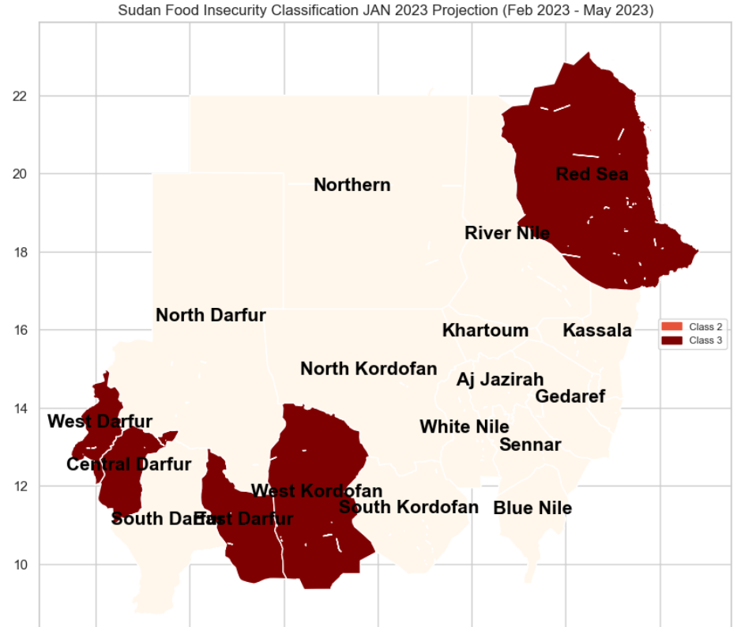
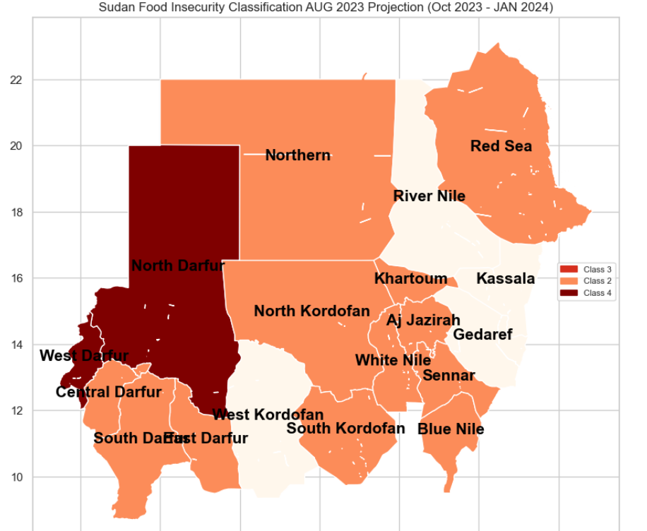
2. c) Political Violence and Food Insecurity
Figure 1: Projected Food Security: Pre-Conflict
Figure 2: Projected Food Security: After Conflict Eruption

Slide 20
2. c) Political Violence and Food Insecurity
In the case of Sudan, the food insecurity situation has significantly worsened in the regions most impacted by political violence.
The comparison between the food insecurity classification projections before and after the outbreak of war is telling. In the November 2022 projection (Figure 1), covering the period from February to June 2023, the food security situation was already concerning but relatively stable. However, in the August 2023 projection (Figure 2), which forecasts the period from October 2023 to January 2024, we observe a sharp deterioration in the food insecurity classification across these regions.
This rapid decline over a few months illustrates how the ongoing violence has severely worsened food insecurity.

Slide 21
2. d) Refugee Movement and Food Insecurity
The recent arrival of over 2.9 million refugees, asylum seekers, and returnees have fled from Sudan. It underscores the critical relationship between displacement and food insecurity.
Political violence and conflict force individuals to abandon their livelihoods and access to local markets, resulting in immediate food shortages. This influx places significant strain on host communities, which may already be resource-limited.
Additionally, large-scale displacement disrupts regional supply chains and humanitarian aid efforts, leaving refugees vulnerable to food shortages.

Slide 22
Section 3: Forecasting risks for future actions

Slide 23
3. 1) Sudan’s Conflict: The Looming Risks
Given the current trajectory, the situation in Sudan is growing increasingly dire. Food insecurity projections signal the country is on the verge of one of the world’s largest hunger crises.
Despite international mediation efforts, peace remains elusive. In May 2023, peace talks led by the United States and Saudi Arabia collapsed when the Sudanese Armed Forces (SAF) withdrew, and since then, no meaningful progress has been made. Both the SAF and the Rapid Support Forces (RSF) continue their violent struggle for power. With no peace negotiations in sight, the risk of further escalation in violence looms large.
As violence and political instability persist, food insecurity remains the greatest danger, threatening to push millions more into hunger. The worsening conflict exacerbates this critical issue, leaving Sudan on the brink of a severe humanitarian catastrophe, with hunger as its most immediate and devastating consequence.

Slide 24
Insights for Future Interventions

